Slide 1
Active Speaker Test Bed
Having Fun with Loudspeakers with DSP and Arduino CPU’s

Slide 2
The Road Ahead
First we build a DSP test bed
Then we build an active speaker from a proven passive design, using the test bed
Then we add a DSP-based subwoofer
Then we make a DSP plate amp
Then we make a nice active speaker with high WAF

Slide 3
Test Bed Purpose
Have a working DSP system to:
  Understand the hardware required for modern active speakers
    What is needed
    Sound quality evaluation
    Amp sizing
  Evaluate DSP algorithms
  Determine how much of a user interface is really needed
  Develop your own Arduino control code
  Evaluate alternate hardware such as different displays and packaging options
Share with others while learning more about DSP

Slide 4
The Test Bed -- Overview
ADAU1701 DSP controlled by an Arduino
  Powerful DSP with great flexibility
  Good sound quality
  Well supported and familiar software environment
    Sigma Studio for the DSP functionality
    Arduino IDE for control
Interface to loudspeaker design tools
  Active Speaker Designer (ASD)
DSP reconfigurable using Analog Devices SigmaStudio design tools
Stand-alone user interface (LCD/Keypad)

Slide 5
The Test Bed – Block Diagram
DSP
Tweeters
Multi-Channel Amp
Stereo in
Woofers
I2C
LCD Display/KBD
Controller (Arduino)
USB/Serial
SigmaStudio Software
ASD Software
Arduino IDE & code

Slide 6
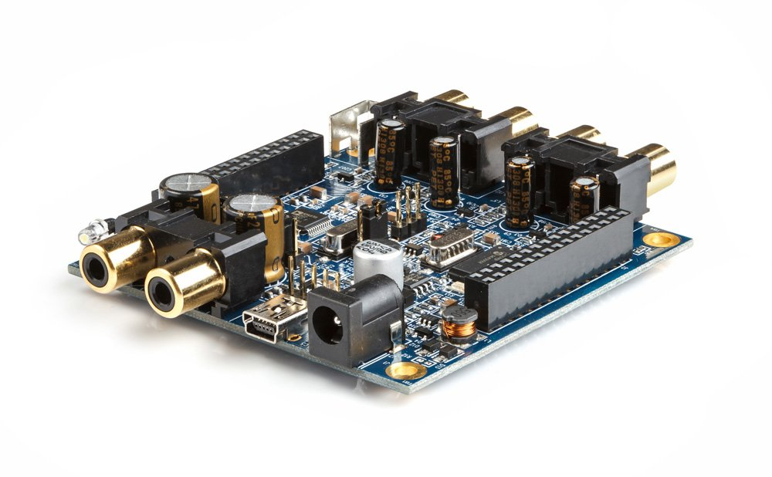
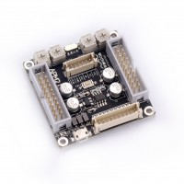
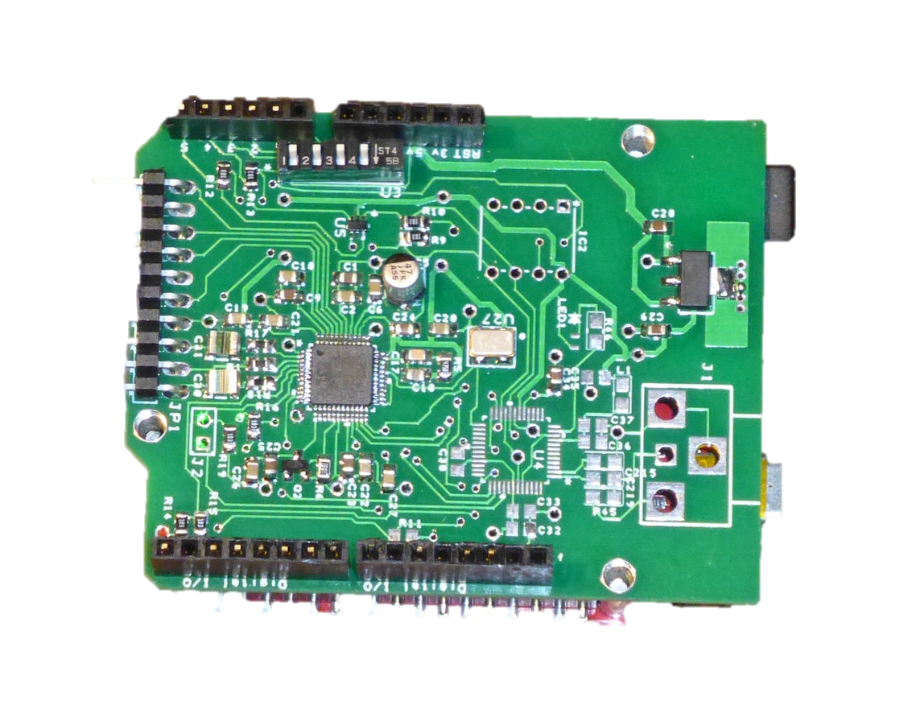
The Test Bed – DSP Alternatives
DSP Alternatives
MiniDSP
  Wait until local CPU loads the ADAU1701 and then take over the I2C bus
    Load your own code & control DSP from the Arduino
  RCA connectors; (2 in; 4 out) has output filters
  Requires 3.3V CPU
  ~$80
Sure DSP (AA-AP23122)
  Wait until selfboot completed and then take over I2C bus
  Requires special connectors or else use Interface Extension kit with 3 RCA outputs
  $20 to $30
Audiodevelopers Arduino Shield
  Open HW design but challenging to build
  Several completed boards available for $25 (cost of parts)
  Has level shifters for 5V Arduino CPU
  Version available for stereo 3-way
MiniDSP
Sure ADAU1701 DSP
Arduino Shield

Slide 7
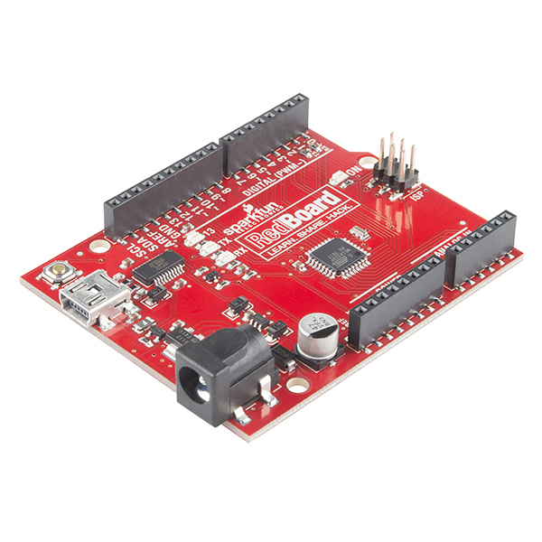
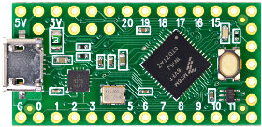
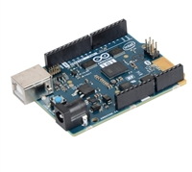
The Test Bed – CPU Alternatives
DSP Alternatives
Arduino Uno
  Cheap—boards available for as little as $5
  Does not currently work with ASD software—needs FTDI Breakout Board ($15)
Sparkfun Redboard
  $20
  Includes FTDI USB to serial converter for ASD interface
  Like Uno, requires DSP with level shifters (5V vs 3.3V)
Teensy Boards
  Range from $13 to $30
  3.3V for direct connection to ADAU1701
  Small but more powerful, although speed not critical for this application
  No ASD interface without FTDI breakout board—yet (may be coming)
Many others
  Intel Curie and many other variants supported by Arduino IDE
Sparkfun Redboard
Teensy LC
Intel Curie or others

Slide 8
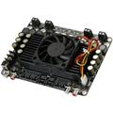
THE Test Bed – Amp Alternatives
Any 4-channel amp will work, but the test bed will focus on the PE 320-305 Board
  Sure Electronics AA-AB33184
  4x100W Class-D Amplifier using the TDA7498
  Easy to convert to a plate amp
    Remove fan and bolt the heatsink to the plate for heat removal from the box
  Available as a 6-channel version
    Extra power amps for “pushing” small woofers
  Reasonable price ($50)

Slide 9
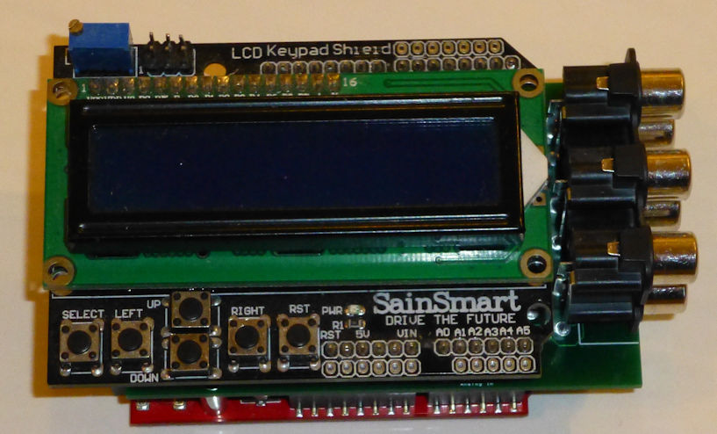
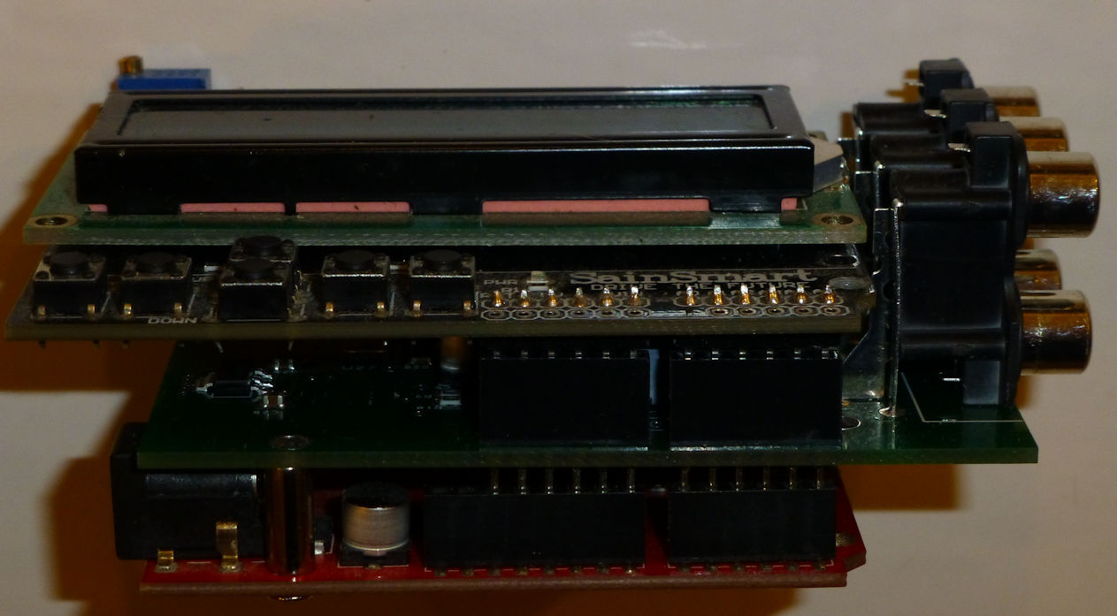
Sample Test Bed Hardware (Less Amps)
Front View
Side View
LCD Display
DSP Board
Sparkfun Redboard

Slide 10
Software Part 1: SigmaStudio
Actually not required if a “standard” DSP configuration is used (see next page)
Required if you want to experiment with custom DSP configurations
  We will be testing the SuperBass and Phat-Stereo algorithms “down the road”
  Small box configurations will also need dynamic volume control
Required if you really want to understand how the ADAU1701 works
Available at http://www.analog.com/en/design-center/processors-and-dsp/evaluation-and-development-software/ss_sigst_02.html
The test bed project will not explore using SigmaStudio in detail, but will reference the software on many occasions, so familiarity with this tool will be helpful

Slide 11
“Default” SigmaStudio Design

Slide 12
Comments on that SigmaStudio Design
Kind of complicated looking, eh?. But again, you can just use this as is…you don’t have to work with SigmaStudio unless you want to.
Each of those blocks is a “cell”, and most of them are digital biquads
  Biquads require 5 instructions, other cells typically require 1 to 3 instructions per audio sample
  The ADAU1701 executes 1024 instructions every audio sample, so you can have ~200 biquads
  Each biquad can implement a 2-pole filter, so this chip has plenty of DSP resources
On the left: Input selection (analog/SPDIF) and Master Volume Control
On the top: 12 biquads (for 9-channel equalizer and BSC filter plus two “spares”)
In the middle: 6 channels, with 8 biquads for each channel
  Enough for a very steep 16-pole filter for each channel, if you want
Toward the right side: Delay for each channel (180 audio samples)
On the right: 4 analog outputs and 2 serial (I2S outputs)
  Enough for a stereo 3-way crossover if we add a serial DAC

Slide 13
Active Speaker Designer (ASD)
Developed by the author mostly for “personal use”
  Started out many years ago as Excel macros, so code is in VB.net
Comprehensive loudspeaker design tool
  Box modeling, baffle diffraction modeler, and amplifier models
  DSP processing (math models of the DSP operations)
  FRD/ZMA formatting/processing tools (including minimum phase extraction)
Can accommodate just about any DSP board
  Started out as a tool for designing with the TAS3004, then the STA308/STA328, and now ADAU1701
  Models DSP boards and their configurations, such as channel assignments
  Models the registers and features in support chips such as ADC’s, DAC’s and delay IC’s
  Provides real-time control of DSP via USB interface
Real-time control interface communicates with 68S08 micro or Arduino software
Database tools for drivers and TS parameters
Free download (executable) at http://www.audiodevelopers.com/Software/ASD/setup.exe

Slide 14
Role of ASD in the Test Bed
We will use ASD to predict the performance of an active speaker
  Import driver measurements
  Interactively adjust the filters, delay and volume needed to achieve the desired results
  Download the filter parameters to the Arduino board (new feature to be developed)
ASD processes the output of the SigmaStudio compiler
  This may become a stand-alone tool, but right now it is bundled with ASD
ASD will be used to “debug” and control the ADAU1701
  It reads and displays the ADAU1701 memory and Registers
  It can provide much more control than the local LCD/keypad user interface
  It can program an EEPROM for ADAU1701 boards so equipped (such as the Sure DSP)

Slide 15
Arduino Code, Part 1: ASD Interface
Responds to commands from USB interface to manage ADAU1701 in real time
Commands use a command code followed by parameter data
Data is received as ASCII characters
  Example: 0x45 is received as ASCII ‘4’ (Dec 52) followed by ‘5’ (Dec 53)
Code | Description | Code | Description
? | dead or alive test--no parameters | Z | Master Volume
A | Set I2C Address | C | Channel Volume
T | Set I2C MSB subaddress for 16-bit addresses | X | Delay
M | Variable length I2C message | F | Filter Spec
R | Read from I2C address | I | Input Code
L | Read a block from I2C addresses | P | Parameter RAM block save/load
V | Mute/unmute

Slide 16
Arduino Code, Part 2: LCD/Keypad Interface
The LCD interface is table-driven and fairly easy to modify (if you want)
  Someone could easily write a graphical tool to create the tables – left as an exercise
The table consists of the pages and fields on each page. Each field has a list of values that are specified in the table
  The Up and Down keys select the next or previous values
  The Left and Right keys select the next field or go to the next page if at the last field
Whenever a value is changed, the DSP is updated with the new values
Whenever a new page is selected, the HCI state is saved to EEPROM.
On boot-up the HCI state is restored from EEPROM
A rotary encoder or IR interface can mimic the keypad operation

Slide 17
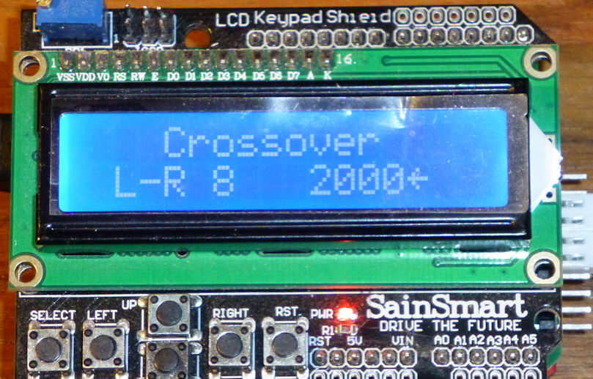
LCD/Keypad Interface
Currently supports 6 crossover types at 7 frequencies
  None, B-W 1, B-W 3, L-R 2, L-R 4, L-R 8, at 1200, 1600, 2000, 2400, 2800, 3200, 3600Hz
Baffle Step at 8 frequencies between 300Hz and 1KHz; 0 to 6db for each frequency
Master volume and volume trims for each channel
Delay for each channel
Input Select (analog vs SPDIF—not implemented)
9-band EQ
  50, 80, 300, 600, 900, 2000, 5000, 8000, 13000Hz
  -10db to +10db in 2db steps

Slide 18
Arduino Code, Part 3: DSP Calculations
IIR coefficients for crossovers are recalculated every time the value changes
  Uses 32 bit floating point math library
  Noticeable “lag” due to 8 bit CPU, but less than ½ second for 8-pole crossover
  Teensy boards with M4 Cortex processor have no noticeable delay (hardware floating point)
Peaking filters (EQ) and shelving filters (BSC) coefficients recalculated in near real time
Coefficients sent to the ADAU1701, which actually implements the filters
  Uses Safeload registers to minimize pops and clicks from filter settling
Relatively compact code: easily expanded for more DSP, even for the 8-bit micros

Slide 19
So what Can I do with this Testbed?
It already works—you can use this right away for stereo 2-way speakers
  Select a crossover, add BSC and some EQ using the LCD display and you can have a nice speaker
  Or, use ASD to interactively design active speakers using a more sophisticated user interface
  And hopefully the PE community will help develop new “pre-engineered” solutions that you can download into the Arduino
But, you also have the option to change the code in the Arduino
  Example: modify the code so that each DSP board provides a 3-way crossover
  This requires some coding proficiency, but there is a lot of support for Arduino code development
And you can change the code for the DSP with SigmaStudio
  Examples: 24-channel EQ; add bass management algorithms, add dynamics processing etc.
  This requires a fair amount of understanding of how the DSP works, plus coding proficiency, but for some people this will open some new doors…

Slide 20
What Skills are required?
You will need use the Arduino Integrated Design Environment (IDE)
  The CPU needs to have the right code, and it will be “empty” when you buy it
  Fortunately, there are many online tutorials for getting started with the Arduino IDE
  The code will be posted, so there is no code development required, but it needs to get programmed into your Arduino board
  Once the IDE and code is installed, you just hit the “upload” button—it’s that easy
All other programming and DSP skills are optional, but there is a great opportunity here…
  This test bed is really intended to be a learning platform and a starting point for more advanced designs
  And even if you just use other people’s designs, you will learn more about coding and DSP

Slide 21
“Community” Code sharing
(see the license at: https://creativecommons.org/licenses/by-nc-sa/4.0/)
Since the Arduino license will use the Creative Commons “Attribution-NonCommercial-ShareAlike,” people can share their code for non-commercial use. Here are some different scenarios for sharing code:
Scenario #1: suppose someone adds a great bass management algorithm using SigmaStudio to their testbed, along with a new screen page for the LCD to control it. How can you use it?
  Simply download their revised code and load it into your Arduino CPU. Since the SigmaStudio design is captured in the Arduino include files, your testbed will have all of the same DSP features—just by reloading the Arduino.
Scenario #2: suppose someone changes the LCD user interface to implement a 3-way speaker instead of the 2-way design
  That’s a more complicated problem, because there will be a “fork” in the code. You will need to select the 3-way code instead of the 2-way. But you could always reload the 2-way if you wanted.
Scenario #3: suppose you want to use a different LCD display—for example, a touch screen that mounts on the front of the loudspeaker.
  If written properly, this will be a complementary user interface code that can be added to a common baseline without causing a “fork”. You can just add the new code and as long as it doesn’t “interfere”, it will simply be a new capability that isn’t used unless someone has that hardware.

Slide 22
Test Bed “Schedule”
Make Arduino code available to a limited circle of PE board members
  Send out ADAU1701 shield boards
  Create a review team
  Get some inputs on how to improve the code for a broader user base
Finish the ASD interface code for the Arduino and remaining DSP functions
“Clean-up” ASD and post new version
Post the Arduino code with limited license (CC: Noncommercial, ShareAlike, Attribution)
Order amp board and power supplies
Design cables and test the Arduino software with Sure DSP and miniDSP
Finish the write-up for the PE Design Team page

Slide 23
Down the Road Schedule
TBD, but most likely sequence of projects will be:
  Active speaker vs established kit
    Requires a relay board to compare speaker with and without passive crossover
  Experiments with bass enhancement algorithms
    See how much we can get from a small speaker driven with lots of power
  Active speaker plate amp
    New board already in development for this design
  3-way active loudspeaker

