Slide 1
ADAU1466 Arduino Software
4/19/2023

Slide 2
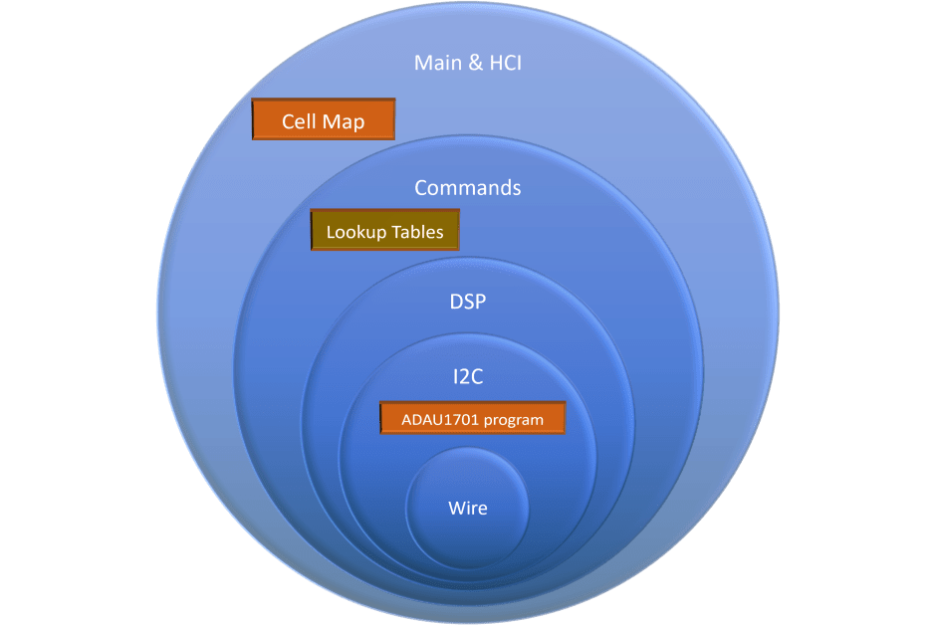
Overview
Same overall design as ADAU1701, except for the “ADAU1701 program” block.
For the ADAU1466, the program is put in the EEPROM by SigmaStudio

Slide 3
Model View Controller
Inputs
(Views)
Model
Command Execution
(“Controller”)
Outputs
(Views)
Status, allowable values and up/down management
Volume
Serial Debugger
MQTT Message
Input Selection
MQTT Message
Bluetooth BLE (UART)
Crossover
BLE messages
Serial Debugger
EQ
Mute
Update_Model()
Execute_Command()
Update View()
Other DSP functions

Slide 4
The Model
The Model defines the DSP functions and the current state of each function
List of functions or capabilities:
State of each function:
Main_volume, Mute, Input, chan_vol_Tweeter, chan_vol_Woofer, chan_vol_Sub,
Delay_Tweeter, Delay_Woofer, BSC_freq, BSC_Gain,
Xover_TW_type, Xover_TW_freq,Xover_WS_type, Xover_WS_freq, EQ_50_Gain, EQ_80_Gain, EQ_300_Gain, EQ_600_Gain, EQ_900_Gain, EQ_2K_Gain,
EQ_5K_Gain, EQ_8K_Gain, EQ_13K_Gain, EQ_reset_Gain,
Rumble_filter_freq, Rumble_filter_Q, Bass_Enhancement_Mode, Peak_filter_freq, Peak_filter_Gain, SuperBass_freq, SuperBass_Intensity, SuperBass_Gain,
etc…
current value
default_value;
number_of_values;
pointer to table of value responses

Slide 5
Controller
The controller executes the commands.
Library functions are called to control the DSP:
ADAU1466_cmd: Top-level functions for executing the commands
ADAU1466_DSP: DSP functions such as filters and crossovers
ADAU1466_Bilinear: Coefficient calculations for biquads
ADAU1466_SPI: SPI communications and safeload
ADAU1466_Lookup_tables: conversions for volume values, delays, Superbass routines
ADAU1466_Shared_enums: enumerations for filter types and crossovers

Slide 6
Views
Inputs: Serial Debugger, Bluetooth-LE or MQTT
All inputs converted to Update_Model(command, value)
Relatively easy to add a new class of inputs such as rotary encoders, IR remote, etc.
HCI handler supports next/previous value commands to support navigation keys
Outputs: BT, debugger or MQTT messages
Common output type: serial message that echoes command code and value from the Model table
Other outputs are handled with device-specific code

Slide 7
Initialization—out of date
Declarations
Define Structures
Menu & Display Init
ADAU1701 Init
Nextion Display objects
CPU Init
Load ADAU1701 Program
(Prog_table in Arduino_shield.h)
DSP: filters, Xover, Biquad, Coefficient struct
Initialize HCI menu data
Pins
SCI & HCI global variables
HCI Menu: field, page, menu
Serial Ports
Init menu state
Load ADAU1701 Parameters
(Param_table in Arduino_shield.h)
Files created by ASD program from SigmaStudio output
I2C (Wire)
Set up callbacks for each display object
Cell Map Constants
Cell_map.ino
HCI Menu parameters and display values (constants)
ADAU1701 memory tables
Arduino_shield.h
Load ADAU1701 Registers
Initialize display from menu

Slide 8
User Input—Out of date
Menu-driven User Interface
SCI
GUI Commands
Main Loop & callbacks
Wait for complete command
Determine command type and parameters
Bluetooth BLE
See “Update HW from GUI”
SCI2
Check for activity on serial ports
Update menu state
WiFi (MQTT)
Callbacks
NexButtons
Update menu state
Menu Commands
Echo menu cmd & display value to client
See “Update HW from Menu”
Check for IR signal
IR
Update menu state
The only user input source for the ADAU1466 program is the cell phone app.
This interface is Bluetooth BLE, with placeholders for MQTT or other WiFi protocol.

Slide 9
Update HW from Menu
Note: Bass Enhancement and Custom Filters added 11/17/2017 but not shown on this diagram
Update HW from Menu
Branch on HCI field_ID
Each field_ID type has number of variants indicated by parentheses. Example: there are 4 field_ID’s for delay: Delay_L_Tweeter, Delay_R_Tweeter, Delay_L_Woofer, Delay_R_Woofer
Main Volume
Look up actual volume from volume code
Chan Vol (6 chans)
Look up actual volume from chan vol code
Biquads are assigned in the Coefficient_calc routine
Delay (4)
Look up actual delay from delay code
Xover Type (2)
Update Crossover Object
Look up Biquad Spec (number, order, Q)
Calculate biquad coefficients
Biquad Safe Load
Xover Freq (2)
Convert to ADAU1701 number (5.23)
Xover Polarity (2)
Set biquad to pass-through or -1
Get Parameter address(es)
BSC Freq (1)
Set biquad to shelf filter @ freq and gain
Set up ADAU1701 registers for safe-write
BSC Gain (1)
Send formatted data to ADAU1701
EQ Gain (9)
Set peaking filter gain

Slide 10
Serial Commands (Page 1)
Commands use either a Command:Value or a Command:Subcommand:Value format. Command is a single ASCII character. Subcommand (and Value) use two ASCII characters to represent a Hex value 0-255. Three values are reserved: “FD” (hex for 253) reloads existing menu value; “FE” selects the previous value in the menu list; “FF” selects the next value in the menu table. The commands return the updated value back to the Bluetooth or WiFi host. If the client needs to interrogate the Arduino to know the current value, it should send a CssFD command, where C is the command and ss is the subcommand.
Volume: Zvv
Stereo Chan Vol: Cssvv
Stereo Delay: Xssvv
EQ: Essvv
Ex: “Z50” sets the volume to the 80th value in the table (0x50 = 80). The value of 80 is used as an index to the Main_Vol_table, which returns the ADAU1466 4-byte word that corresponds to 0 dB.
Sub-cmd (ss) | Field_ID
0 | chan_vol_S_Tweet
1 | chan_vol_Tweeter
2 | chan_vol_Mid
3 | chan_vol_Woofer
4 | chan_vol_Sub
Sub-cmd (ss) | Field_ID
0 | Delay_S_Tweet
1 | Delay_Tweeter
2 | Delay_Mid
3 | Delay_Woofer
(4) | Delay_Sub
Sub-cmd (ss) | Field_ID
0 | EQ_32_Gain
1 | EQ_64_Gain
2 | EQ_125_Gain
3 | EQ_250_Gain
4 | EQ_500_Gain
5 | EQ_1K_Gain
6 | EQ_2K_Gain
7 | EQ_4K_Gain
8 | EQ_8K_Gain
9 | EQ_16K_Gain
A | reset all EQ gains
Ex: “ZFE” sets the volume to the previous value in the table), which is -1 dB. The return message to the client is “Z-1 ”
Main Vol Code | Display Value
0, 1, 2,…85, 86 | -80, -79, -78, … +5, +6
Vol Code | Display Values
0 to 10 | -10, -9, -8, -7, -6, -5, -4, -3, -2, -1, 0
Ex: “X0102” sets delay for tweeter to 3rd entry in table (.56”)
() Delay Reference: Usually zero
Delay | Display Values
0 to 11 | 0, .28, .56, .84, 1.13, 1.41, 1.69, 2.25, 2.81, 3.66, 4.78, 5.91
EQ Gain | Display Values
0 to 10 | -10dB, -8dB, -6dB, -4dB, -2dB, 0dB, +2dB, +4dB, +6dB, +8dB, +10dB

Slide 11
Serial Commands (Page 2)
Xover: Fssvv
Save/Restore: Svv
BSC: Bssvv
Input: Ivv
Sub-cmd (ss) | Field_ID
0 | Xover_ST-T_type
1 | Xover_ST-T_freq
2 | Xover_T_M_type
3 | Xover_T_M_freq
4 | Xover_M_W_type
5 | Xover_M_W_freq
6 | Xover_W_S_type
7 | Xover_W_S_freq
Cmd (vv) | Field_ID
0 | Save (default block)
1 | save to block 1
2 | restore from block 1
3 | save to block 2
4 | restore from block 2
Sub-cmd (ss) | Field_ID
0 | BSC_Freq
1 | BSC_Gain
Sub-cmd (ss) | Field_ID
0 | Bluetooth (amp board)
1 | SPDIF (Wiim Mini)
2 | I2S
3 | Analog
BSC Freq | Display Values
0 to 7 | 300Hz, 400Hz, 500Hz, 600Hz, 700Hz, 800Hz, 900Hz, 1.0KHz
BSC Gain | Display Values
0 to 6 | 0, 1, 2, 3, 4, 5, 6
ST-T Type: 0 to 5 | Display Values: None, B-W 1, B-W 3, L-R 2, L-R 4, L-R 8
ST-T Freq: 0 to 5 | Display Values: 3000, 4000, 5000, 6000, 7000, 8000
T-M Type: 0 to 5 | Display Values: None, B-W 1, B-W 3, L-R 2, L-R 4, L-R 8
Xover Polarity: Fssvv
T-M Freq: 0 to 5 | Display Values: 1000, 1500, 2000, 3000, 4000, 5000
Sub-cmd (ss) | Field_ID
8 | Xover_ST_polarity
9 | Xover_T_polarity
A | Xover_M_polarity
B | Xover_W_polarity
M-W Type: 0 to 5 | Display Values: None, B-W 1, B-W 3, L-R 2, L-R 4, L-R 8
M-W Freq: 0 to 5 | Display Values: 300, 500, 750, 1000, 1500, 2000
W-S Type: 0 to 5 | Display Values: None, B-W 1, B-W 3, L-R 2, L-R 4, L-R 8
Polarity | Display Values
0 to 1 | +, -
W-S Freq: 0 to 5 | Display Values: 80, 100, 120, 150, 200, 300

Slide 12
More Serial Commands (4/2023)
Bass Enh: Kssvv
Custom Filters: Qssvv
Curvature: Pssvv
Shading: Rssvv
Sub-cmd (ss) | Field_ID
0 | Rumble Freq
1 | Rumble Q
2 | Peak Freq
3 | Peak Gain
4 | Bass Enh Mode
5 | SuperBass_freq
6 | SuperBass_Intensity
7 | SuperBass_Gain
Sub-cmd (ss) | Field_ID
0 | Shared1_Type
1 | Shared1_Freq
2 | Shared1_Q
3 | Shared1_Gain
4 | Shared2_Type
5 | Shared2_Freq
6 | Shared2_Q
7 | Shared2_Gain
8 | Tweeter_Type
9 | Tweeter_Freq
A | Tweeter_Q
B | Tweeter_Gain
C | Woofer_Type
D | Woofer_Freq
E | Woofer_Q
F | Woofer_Gain
10 (resp: G) | Sub_Type
11 (resp: H) | Sub_Freq
12 (resp: I) | Sub_Q
13 (resp: J) | Sub_Gain
14 (resp: K) | Clear All Filters
Dipole Comp: Dxxvv

Slide 13
Sigma Studio Interface
SigmaStudio (design DSP architecture)
ADAU1466 Arduino Tool
Arduino IDE
Copy Cell_map.ino to sketch directory
Design used for Marthas:
5 stereo channels
Left = front
Right = back
Master Volume
Shared EQ
Volume trims & Polarity, each channel
10 biquads per chan
Delay for each channel
Create cell map file
Cell_map.ino
Maps the compiler-assigned Parameter RAM addresses to cell names so Arduino can program the DSP using symbolic names
Compile with other sketch files.
Compile to create output files:
XXX_param.h

Slide 14
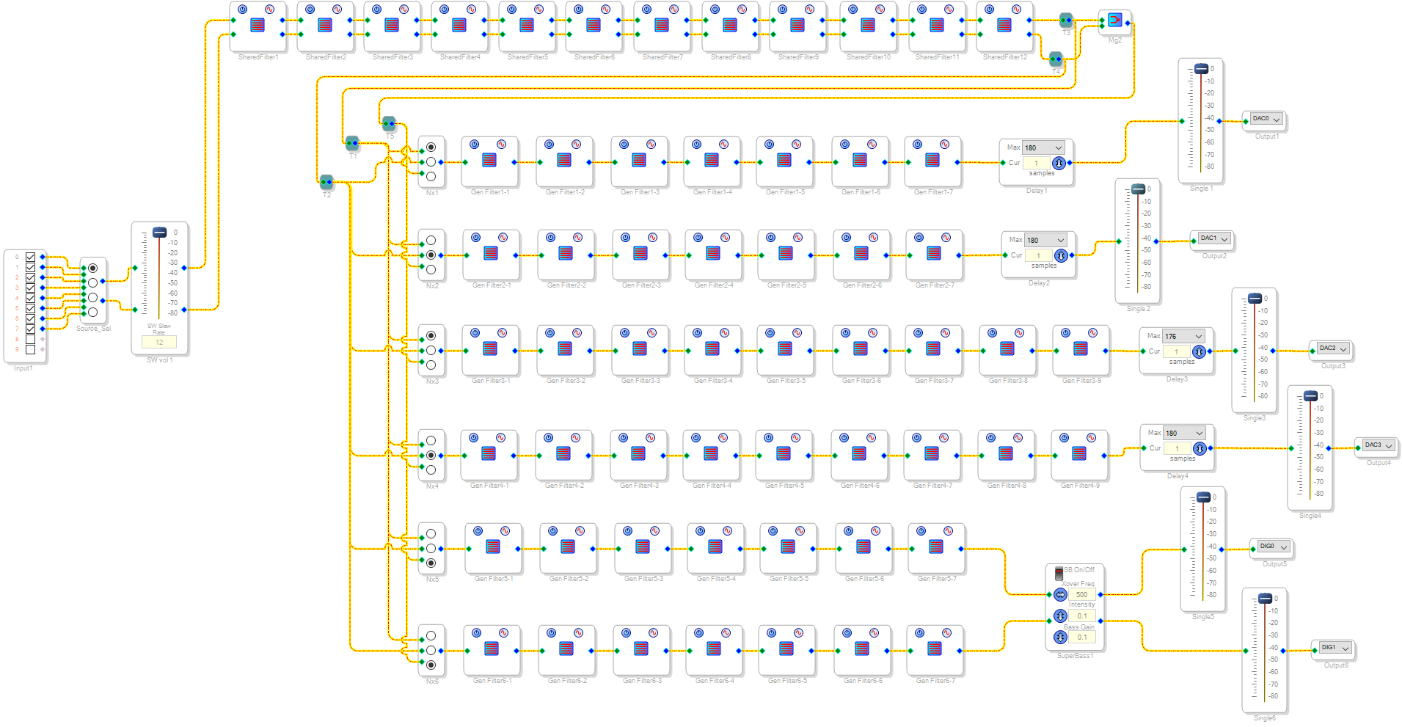
SigmaStudio Design: Stereo 3-way

Slide 15
SigmaStudio Design: 5x2/Dipole

Slide 16
5x2/Dipole
5 stereo channels with polarity control for L/R
Polarity control allows 5-way monopole or 5-way dipole
10-band Equalizer, plus BSC and 2 shared filters
Supports 10-pole crossovers for most drivers
Subwoofer crossover is 8-pole
Delay on all channels for driver offsets
Volume trim with mute for all channels
Bass management similar to subwoofer plate amp
Rumble and Peaking filters
ADI Superbass algorithm
Perceptual filter that adds overtones to give impression of deeper bass

Slide 17
SigmaStudio Design: Line Array

Slide 18
How to add a New Command
Example: Volume Bar Thickness
Insert command name in enums
See enum.h (Thickness)
Add command code to Tables.h
Add character to Command_table (“T”)
Increment number_of_commands
Link command code to command name in SCI_BLE
Example: case 'T’: cmd = Thickness; break;
Add command values to State_model
(Model[Thickness] .xxx
Add value list to Tables.h or use existing list (On_Off)
Add handler to Commands.ino
Allows special processing for each command
Add values to Preferences as needed
See Save_state in Save.ino
See Restore_state, also

Slide 19
Custom Filters
Custom Filters
Options: Shared_1, Shared_2, Tweeter, Woofer, Sub
Filter
Type
Freq
Q
Gain
Shared_1
Shared_2
Tweeter
Woofer
Sub
One_Pole_LP, One_Pole_HP, Two_Pole_LP, Two_Pole_HP, LP_Shelf, HP_Shelf, Bandpass, Notch, Peaking, All_Pass, None
<<
>>
Parameters

Slide 20
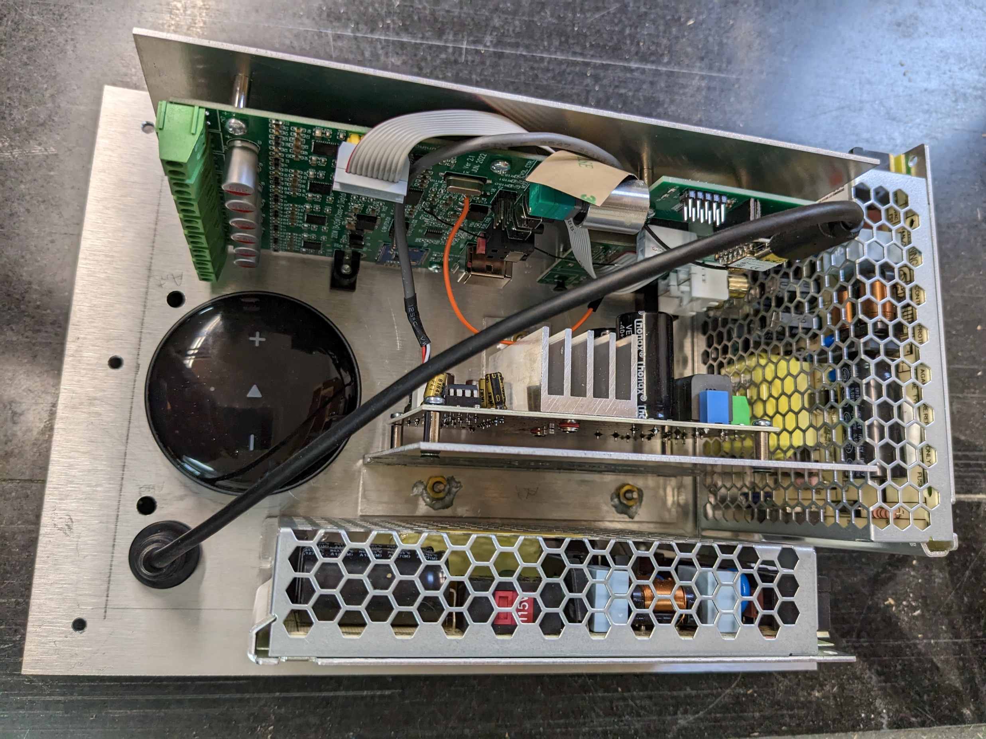
Layout (as used in the Marthas)

